Slide 1



Keamanan Data dan Database
Manajemen Data / Manajemen Basisdata
Universitas Budi Luhur

Slide 2
Overview
Security Overview
Security Requirements
Aturan Otorisasi
Encryption

Slide 3
Security Overview
There are four key issues in the security of databases just as with all security systems
Availability
Authenticity
Integrity
Confidentiality

Slide 4
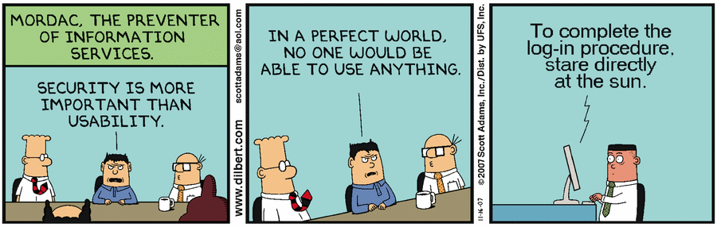

Slide 5
Availability
Data needs to be available at all necessary times
Data needs to be available to only the appropriate users
Need to be able to track who has access to and who has accessed what data

Slide 6
Authenticity
Need to ensure that the data has been edited by an authorized source
Need to confirm that users accessing the system are who they say they are
Need to verify that all report requests are from authorized users
Need to verify that any outbound data is going to the expected receiver

Slide 7
Integrity
Need to verify that any external data has the correct formatting and other metadata
Need to verify that all input data is accurate and verifiable
Need to ensure that data is following the correct work flow rules for your institution/corporation
Need to be able to report on all data changes and who authored them to ensure compliance with corporate rules and privacy laws.

Slide 8
Confidentiality
Need to ensure that confidential data is only available to correct people
Need to ensure that entire database is security from external and internal system breaches
Need to provide for reporting on who has accessed what data and what they have done with it
Mission critical and Legal sensitive data must be highly security at the potential risk of lost business and litigation

Slide 9
Keeping your Data confidential
Although the 4 pillars are of equal importance we are focusing on Confidentiality due to the prevalence of data loss in financial and personal areas
We are going to review solutions for
Internal data loss
External hacking
Securing data if hardware stolen
Unapproved Administrator Access

Slide 10
Security Requirements
Physical database integrity
Logical database integrity
Element integrity
Auditability
Access control
User authentication
Availability

Slide 11
Security Requirements
Physical database integrity. Immunity to physical catastrophe, such as power failures, media failure.
physical securing hardware, UPS
regular backups
Logical database integrity. Reconstruction Ability
maintain a log of transactions
replay log to restore the systems to a stable point
Notes:
Two situations can affect the integrity of a database: when the whole database is damaged (as happens, for example, if its storage medium is damaged), or when individual data items are unreadable.
data must be protected from corruption, either by an outside illegal program action or by an outside force such as fire or a power failure.

Slide 12
Security Requirements
Element integrity. Integrity of specific database elements is their correctness or accuracy
field checks : allow only acceptable values
access controls : allow only authorized users to update elements
change log: used to undo changes made in error
referential Integrity (key integrity concerns)
two phase locking process
Auditability. Log read/write to database
Notes:
DBMSs sometimes take special action to help catch errors as they are made and to correct errors after values are inserted.
the DBMS can apply field checks, activities that test for appropriate values in a position.
Check for value bounds , value types (numeric/character/boolean) , other conditions such as case
Access Controls : Who has authorization to update which elements? What if two people apply conflicting modifications?
What if modifications are applied out of sequence? How are duplicate records detected? What action is taken when duplicates are found?
Change logs : A change log lists every change made to the database; it contains both original and modified values. Using this log, a database administrator can undo any changes that were made in error.
Audibility
For some applications it may be desirable to generate an audit record of all access (read or write) to a database. to discover after the fact who had affected what values and when.
To be useful for maintaining integrity, database audit trails should include accesses at the record, field, and even element levels. This detail is prohibitive for most database applications.
Problem : A log of all records accessed directly may both overstate and understate what a user actually knows

Slide 13
Security Requirements
Access Control (similar to OS)
logical separation by user access privileges
more complicated than OS due to complexity of DB (granularity/inference/aggregation)
User Authentication
may be separate from OS
can be rigorous
Availability
concurrent users: granularity of locking
reliability

Slide 14
Contoh Aturan Otorisasi
Subjek | Objek | Tindakan | Kekangan
Bagian Pemasaran | Data Pelanggan | Menambah | Limit kredit <= 5.000.000
Bagian Akuntansi | Data Pemesanan | Menghapus | Tak ada
Bagian Pemenuhan Pesanan | Data Pemesanan | Membaca Mengubah Menghapus | Tak ada

Slide 15
Implementasi Aturan Otorisasi
Perintah SQL GRANT dipakai untuk menentukan otorisasi akses data
Perintah SQL REVOKE dipakai untuk mencabut otorisasi

Slide 16
Contoh Skenario Hak Akses

Slide 17
Contoh Skenario Hak Akses
Contoh menciptakan user:
CREATE USER arif
IDENTIFIED BY '007arif';
Contoh memberikan hak akses ke arif:
GRANT ALL ON pegawai.* TO arif;

Slide 18
Hak Akses pada MySQL
Hak akses | Keterangan
SELECT | Hak akses ini memungkinkan pemakai melakukan operasi SELECT. Beberapa sistem menggunakan hak akses READ yang identik dengan hak akses SELECT.
INSERT | Hak akses ini memungkinkan pemakai melakukan operasi INSERT
UPDATE | Hak akses ini memungkinkan pemakai melakukan operasi UPDATE
DELETE | Hak akses ini memungkinkan pemakai melakukan operasi DELETE
INDEX | Hak akses ini memungkinkan pemakai menciptakan indeks dan menghapus indeks
DROP | Hak akses ini memungkinkan pemakai menghapus tabel
EXECUTE | Hak akses yang memungkinkan pemakai menjalankan ’stored procedure’ (prosedur tersimpan)
FILE | Hak akses yang memungkinkan pemakai menjalankan SELECT ... INTO OUTFILE and LOAD DATA INFILE
ALTER | Hak akses yang memungkinkan pemakai melaksanakan pernyataan ALTER TABLE untuk mengubah tabel
LOCK TABLES | Hak akses yang memungkinkan pemakai mengunci tabel
ALL | Memberikan seluruh hak akses kecuali GRANT OPTION
GRANT OPTION | Memungkinkan hak akses bisa diwariskan

Slide 19
Hak Akses
Memberikan hak akses SELECT saja:
GRANT SELECT
ON pegawai.* TO novi;

Slide 20
Membatasi Hak Akses pada Kolom Tertentu
GRANT SELECT
ON pegawai.infoprib TO terra;
GRANT SELECT
ON pegawai.bagian TO terra;
GRANT SELECT (nip, kode_bag), UPDATE (nip, kode_bag)
ON pegawai.pekerjaan TO terra;

Slide 21
GRANT OPTION

Slide 22
How about Encryption?

Slide 23
Before Deciding on Encryption
Know the data and the database
What should be encrypted?
Which encryption algorithms?
DBMS or external encryption?
What is the acceptable performance hit?
Who are you protecting against?
Is the benefit worth the cost?

Slide 24
The Role of Encryption
Most database security techniques focus on controlling access – passwords, privileges, encrypting data as it travels
There is much less focus on protecting data at rest (data in storage)
We are assuming here that access encryption has already been used – this lecture focuses on data in storage
Encryption is increasingly being used to protect data in storage
Which includes backups
And all the pen drives, portable hard drives, mobiles that get lost or stolen
Encryption is often described as ‘the last line of defence’

Slide 25
Whole Database Encryption
The whole database is encrypted
This protects the data at rest but requires decryption for use
Whole DB encryption has traditionally been regarded as too expensive – SQL Server TDE, new with 2008, claims to reduce the performance hit but still acknowledges a cost (1)

Slide 26
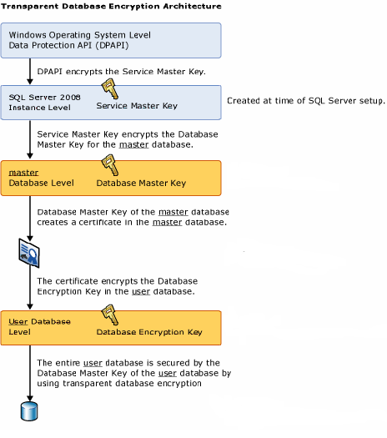

Slide 27
Partial Data Encryption
Partial encryption provides more granularity plus the data is not decrypted until it is used
Usually referring to column encryption although it can also be cell level or encryption of DB objects such as triggers
Rule of thumb – encrypting a single column is likely to produce a 5% performance hit, but this varies wildly
Traditional partial encryption can produce a massive performance hit as indexes are not recognised – but this depends on the DBMS
Highly configurable – can allocate different keys to different users
With the downside that this increases the key management problem

Slide 28
Partial Data Encryption
For SQL Server 2008, Microsoft suggest that with cell level encryption, basic query performance tends to be around 20% worse.
Problem increases with scaling
“One sample application with 10,000 rows was four times worse with one column encrypted, and 20 times worse with nine columns encrypted. Because cell-level encryption is custom to each application, performance degradation will vary depending on application and workload specifics.” (1)
“Custom to each application” - this is an “it depends” area

Slide 29


The Encryption Process
Encrypt
Cyphertext
Decrypt
Plaintext
Plaintext

Slide 30
Encryption Algorithms: Data Encryption Standard
DES has a short (56 bit) key plus 8 bits used for parity checking
Very susceptible to brute force attacks
“No sane security expert would consider using DES to protect data.” (2)
Now outdated – older versions of DBMS encryption routines used DES e.g. early versions of Oracle

Slide 31


Encryption Algorithms: 3DES
The limitations of DES led to 3DES – uses the DES algorithm but employs a triple key approach
Plain Text
Much more secure but slower
Cipher Text

Slide 32
Encryption Algorithms: AES
Key size 128,192 or 256 bits
Consists of a set of processing rounds – the number varies depending on the key size e.g. 14 rounds for 256 length keys
More secure

Slide 33
Encryption Algorithms:RC5
Symmetric (same key used for en/decryption) block cypher
Fast and flexible – the user can specify the number of rounds
Allows for a variable length key
Supported in Oracle & DB2

Slide 34
Encryption in the DBMS
Some of the initial problems with DBMS encryption are on the way to being solved
Disk size was a major problem as ciphers may produce output in fixed block sizes, meaning that the input must be padded – requiring resizing of columns
DBMS encryption was typically criticised for using outdated algorithms such as DES & even 3DES
Sometimes compatibility issues
A plus with DBMS encryption is that there should be minimal change implications

Slide 35
References
Slide “Administrasi Data dan Database” oleh Tim Dosen Universitas Budi Luhur
Slide “Database Security” oleh Amit Dandekar dan Hossein Saiedian, KU Electrical Engineering and Computer Science
Slide “Database Security & Encryption” oleh c.stanier@staffs.ac.uk
Slide “Databases and data security” oleh Valerie Buitron, Jaime Calahorrano, Derek Chow, Julia Marsh, dan Mark Zogbaum
Buku MySQL5: Dari Pemula Hingga Mahir

Slide 36
Thank you
Slide ini disusun oleh Dr. Achmad Solichin, S.Kom, M.T.I (achmad.solichin@budiluhur.ac.id | @achmatim) untuk matakuliah Manajemen Data / Manajemen Basis Data di Universitas Budi Luhur

